Slide 1
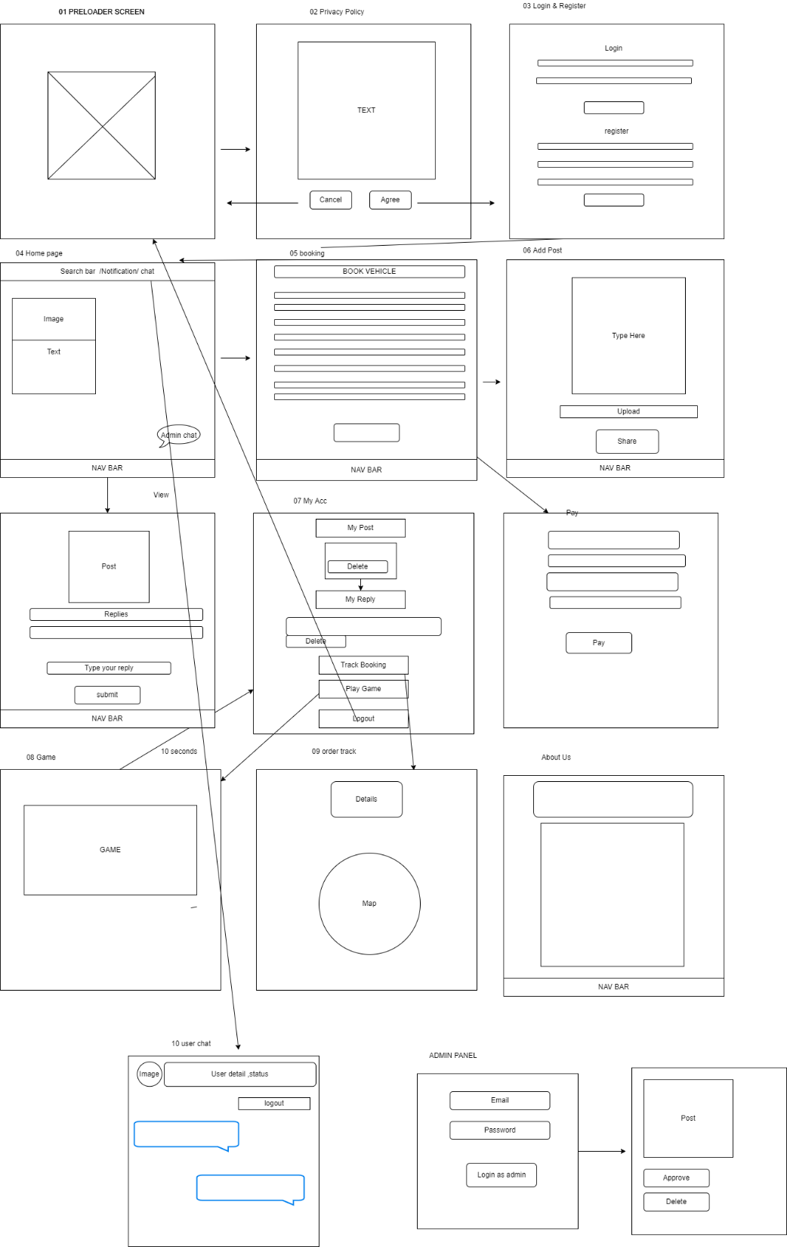
Structure Presentation
Wireframe and sketch

Slide 2
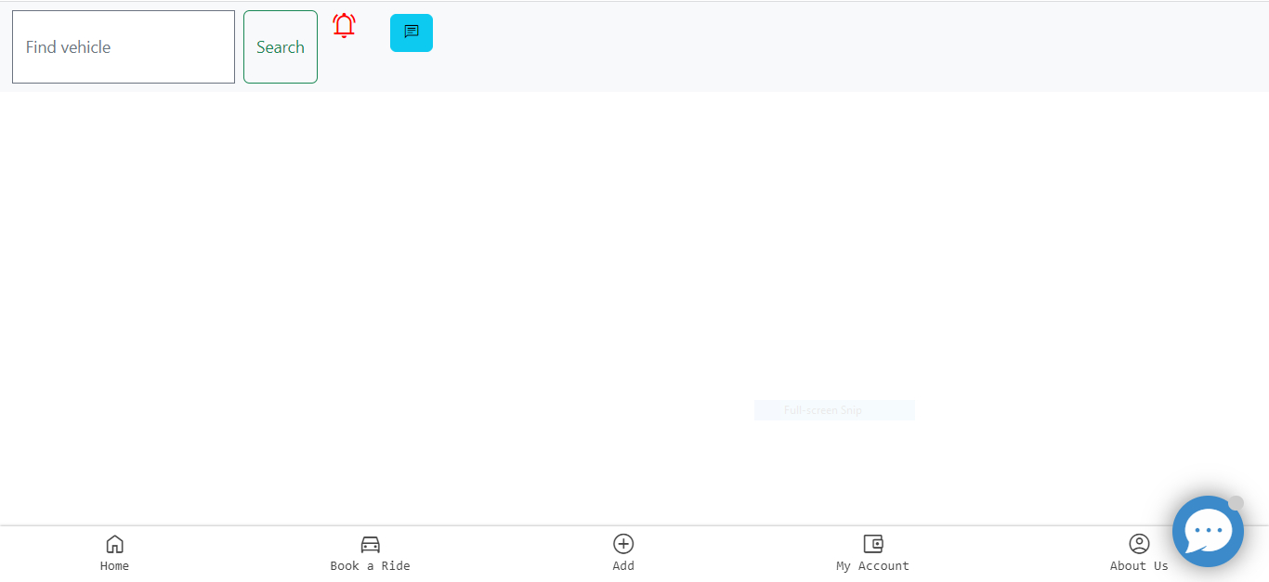
Sample UI Design

